Slide 1
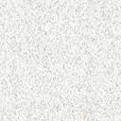
Ocular Disease Recognition

Slide 2
Team Members
Suraj Rajeshwar Bhute [21MM61R03] - Implementation of VGG16 model from scratch and through Transfer Learning
Abhishek Naresh Selokar [21MM62R10] - Image Pre-processing and applying Machine Learning models

Slide 3
Introduction
Eye diseases have been a severe problem worldwide.
The problem is resolved by classification with the help of pattern recognition.
Convolutional Neural Networks are a type of deep learning architecture used in intelligent pattern classification
This work introduces a novel algorithm for clever pattern separation based on the Convolutional Neural network (VGG16 model)
Four different groups of retinography images are given to VGG16 model and Two different groups of images are given to different ML model

Slide 4
1. Retina
The retina is a thin, delicate, transparent sheet of tissue derived from the neuroectoderm.
It is the light-sensing tissue that resides on the back of the eye.
2.Papilla or Optic Disc (OD)
The visible part of the optic nerve that is rounded or oval in a vertical direction, 1.5 mm in diameter;
White-pinkish color, with a whitish central area that corresponds to the physiological excavation known as the Optical Cup (OC) and is of variable size, not exceeding 30% of the OD diameter.

Slide 5
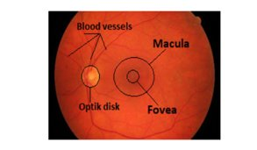
3.Retinal vessels
In the center of the optic disc is the vascular bundle formed by the central retinal artery and vein, which are divided into the superior and inferior temporal arteries and veins
Branches of the retinal vessels approach from all sides
4. Macula
located approximately two diameters (OD) from the papilla.
Fig 1. The retina of the eye is the entire orange circle. The OD is the yellowish part, blood vessels, and macula.​

Slide 6
Retinal Diseases
1) Glaucoma
There are three main methods used to detect Glaucoma: Intraocular Pressure Measurement (IPM), Function-Based Visual Field Test (FBVFT), and Optic Nerve Head (ONH).
The ONH test is easy to diagnose Glaucoma at its earliest phase.
It uses various morphological parameters such as the vertical Cup-to-Disc Ratio (CDR), Edge-to-Disc Ratio (EDR), Neuro-retinal Border Ratio (NBR), and disk width to detect Glaucoma in retinal images
the diagnosis of Glaucoma using the ONH method is achieved by examining OD.
Normal eye contain millions of nerve fibers that run from the retina to the optic nerve.
from the retina to the optic nerve, located in the center of the OD. If Glaucoma is present, the OD becomes hollow, and the optic nerve assumes the shape of a cup (OC)

Slide 7
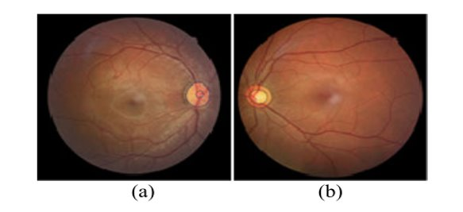
Fig 2. Retinography a) shows an entirely healthy eye and b) has Glaucoma. ​

Slide 8
2) Diabetic Retinopathy
Diabetes mellitus occurs when the pancreas cannot secrete enough insulin, which affects the circulatory system and generates an increase in glucose, which causes the deterioration of the blood vessel walls that leads to bubbles, obstructions, and leaks in the veins.
Micro-Aneurysms (MA): they are small dark red dots.
Exudates are masses of cells, and fluid seeped out of blood vessels or organs, especially in inflammation.

Slide 9
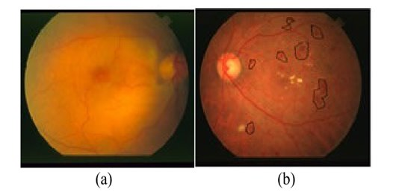
Fig 3. a) Healthy retinography. b) A diabetic retinography​

Slide 10
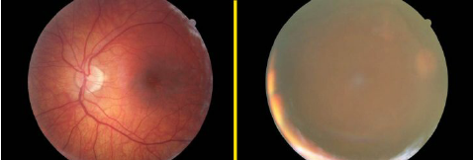
CATARACT 1) A cataract is a cloudy area in the lens of the eye that leads to a decrease in vision. 2) Cataracts often develop slowly and can affect one or both eyes. 3) Symptoms may include faded colors, blurry or double vision, halos around light, trouble with bright lights, and trouble seeing at night.
Figure 4. Retinography a) shows an entirely healthy eye and b) has Cataract

Slide 11
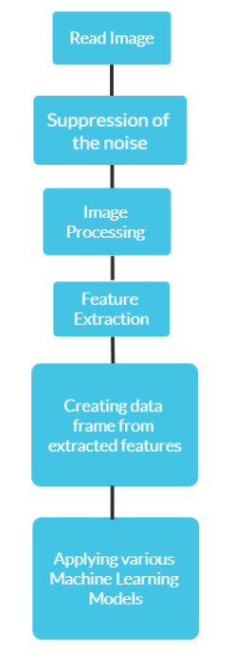
Flowchart of conventional machine learning based classification

Slide 12
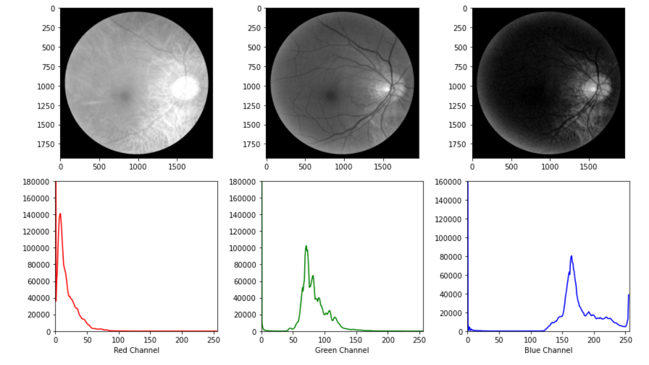
Image preprocessing
Channel Wise Splitting
Plotting histogram
Analyzing histogram

Slide 13
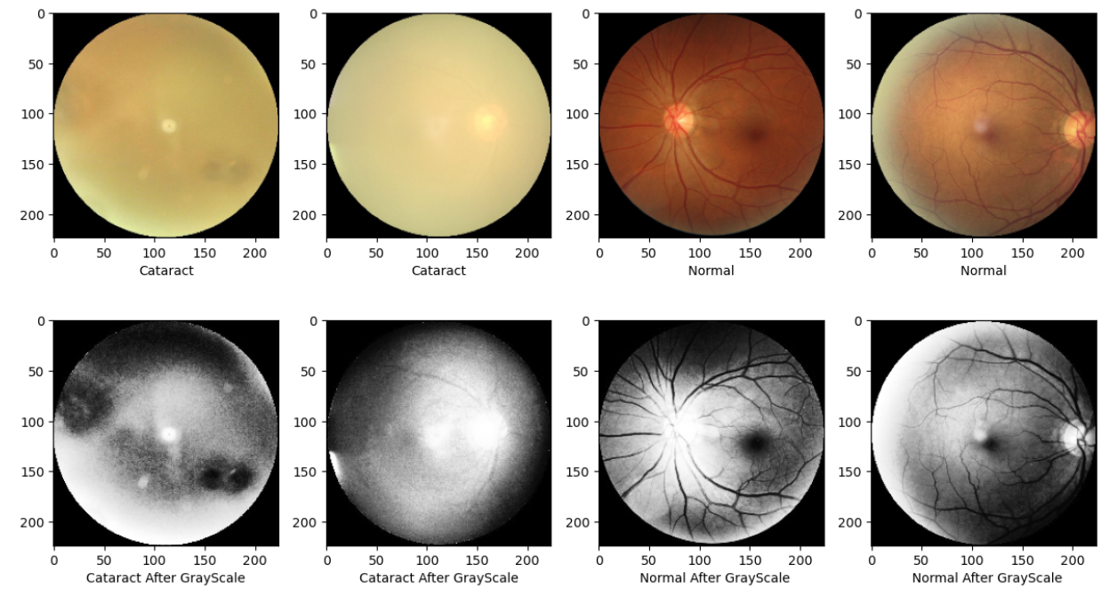
Converting to Grayscale
As can be seen Green channel has maximum contrast so extract only Green Channel

Slide 14
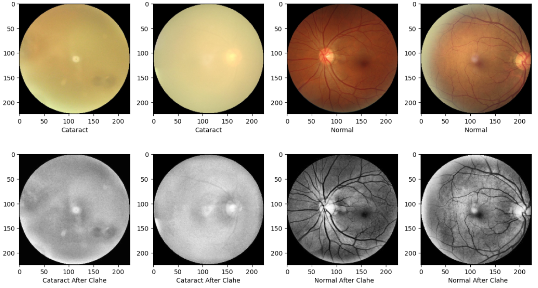
Contrast Limited Adaptive Histogram Equalization
Applying CLAHE for contrast Enhancement

Slide 15
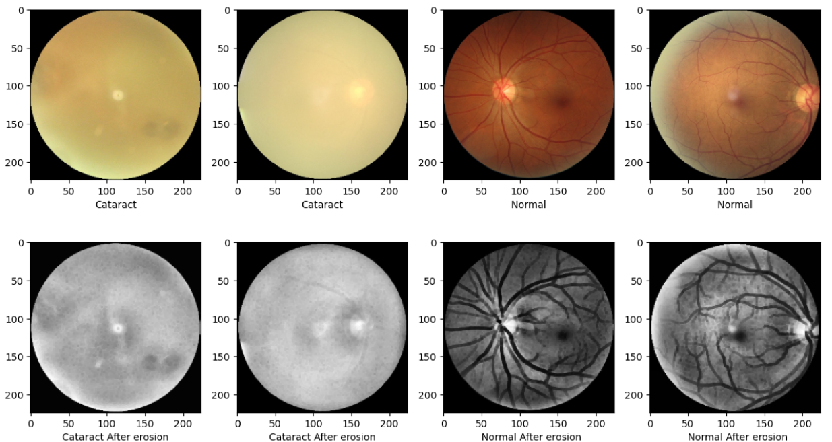
Erosion
Shrinks the image pixels i.e. it is used for shrinking of element A by using element B.
Removes pixels on object boundaries.
The value of the output pixel is the minimum value of all the pixels in the neighborhood. A pixel is set to 0 if any of the neighboring pixels have the value 0.

Slide 16
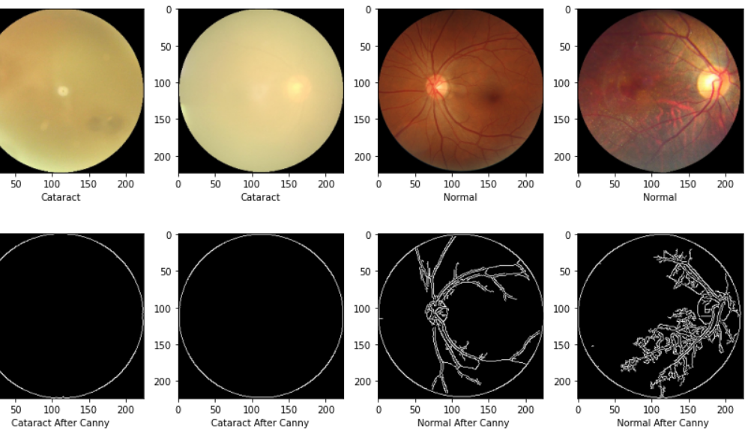
Edge Detection
Canny edge detection is used

Slide 17
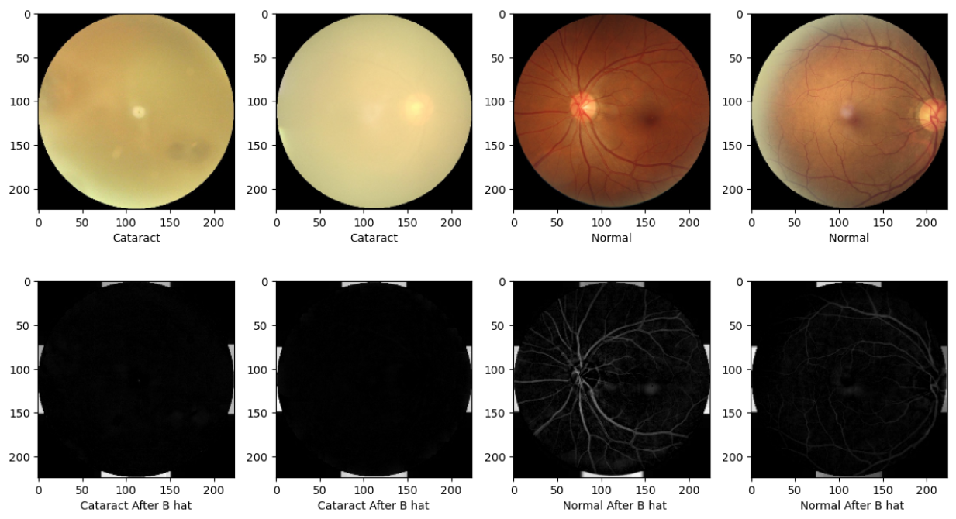
Bottom Hat
By using Bottom-hat transform, it is possible to obtain details of the image as the edge, surface and size. This process allows extracting the dark features.

Slide 18
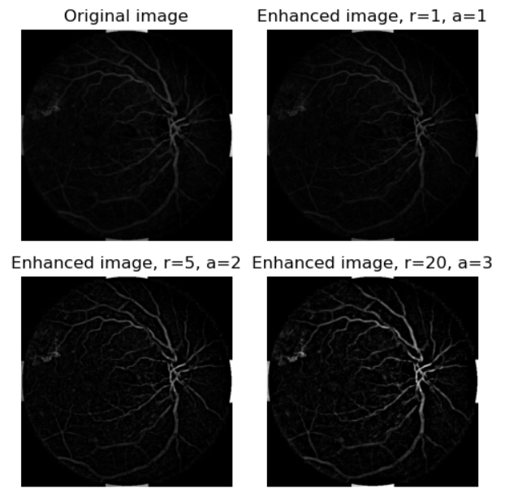
Exudates Detection

Slide 19
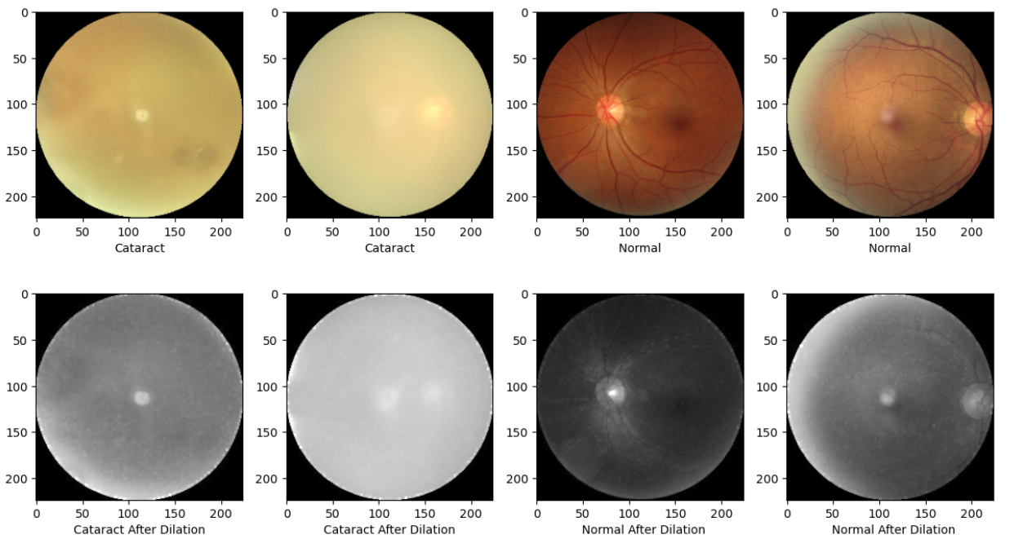
Removing Blood Vessel
Dilation on Red Channel

Slide 20
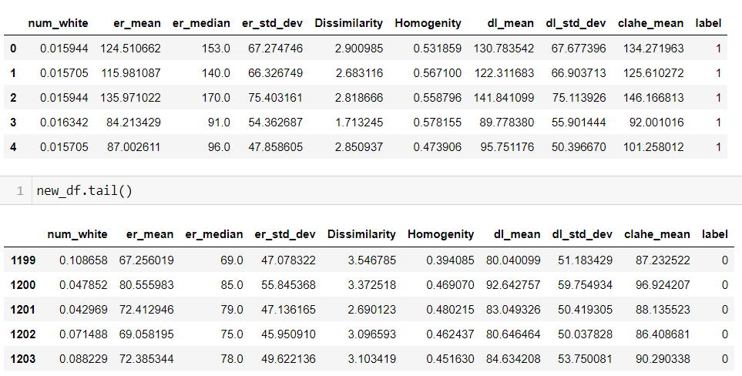
Features :

Slide 21
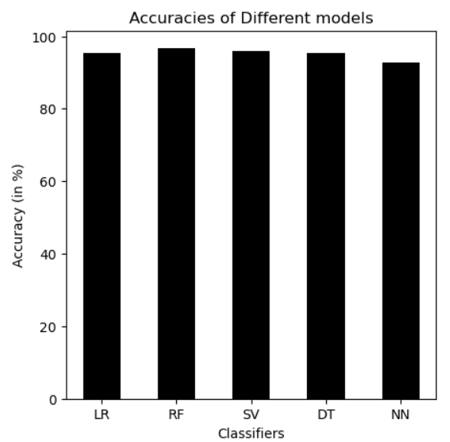
Comparison Of Accuracy among different ML Models

Slide 22
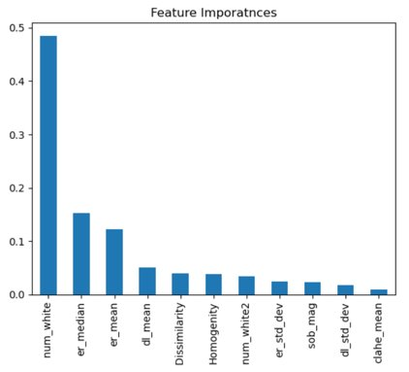
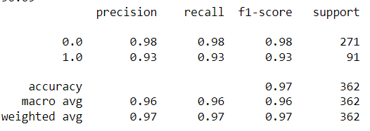
Random Forest accuracy 96.69%

Slide 23
CONVOLUTIONAL NEURAL NETWORKS
CNN consists of series of layers of convolution, grouping, and fully connected multilayer perceptron
It also consists of specific parameters used, such as activation functions.
Feature maps are created with convolution filters, whose weights depend on their size
Convolution is similar to the operation of a mask in image processing
After obtaining feature maps, the ReLU function is applied to break the linearity in the image and extract the most outstanding features from the maps
In the grouping layers, in the maps obtained, the average of the neighbouring pixels is calculated, or the largest is selected, to speed up the processes and reduce the maps sizes.
The most widely used function is Max-pooling, which consists of taking the highest value of a neighbourhood of pixels in an image.

Slide 24
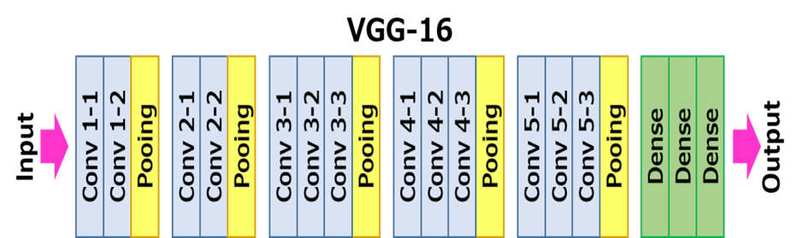
VGG-16 NETWORK ARCHITECTURE:

Slide 25
VGG-16 consists of 16 learnable layers in which 13 are the convolutional layers and the other 3 are fully connected layers.
After every convolution layer in the network, we have used ReLU functions which help to prevent the exponential growth in the computation required to operate the neural network and it prevents vanishing gradients.
At the output, the softmax activation function is used as it is a multiclass classification.
It is considered to be one of the excellent vision model architectures to date.
Most unique thing about VGG16 is that instead of having a large number of hyper-parameters they focused on having convolution layers of 3x3 filter with stride 1 and always used the same padding and maxpool layer of 2x2 filter of stride 2.
The input image is resized into the image standard size of 224*224*3 to this VGG-16 model.

Slide 26
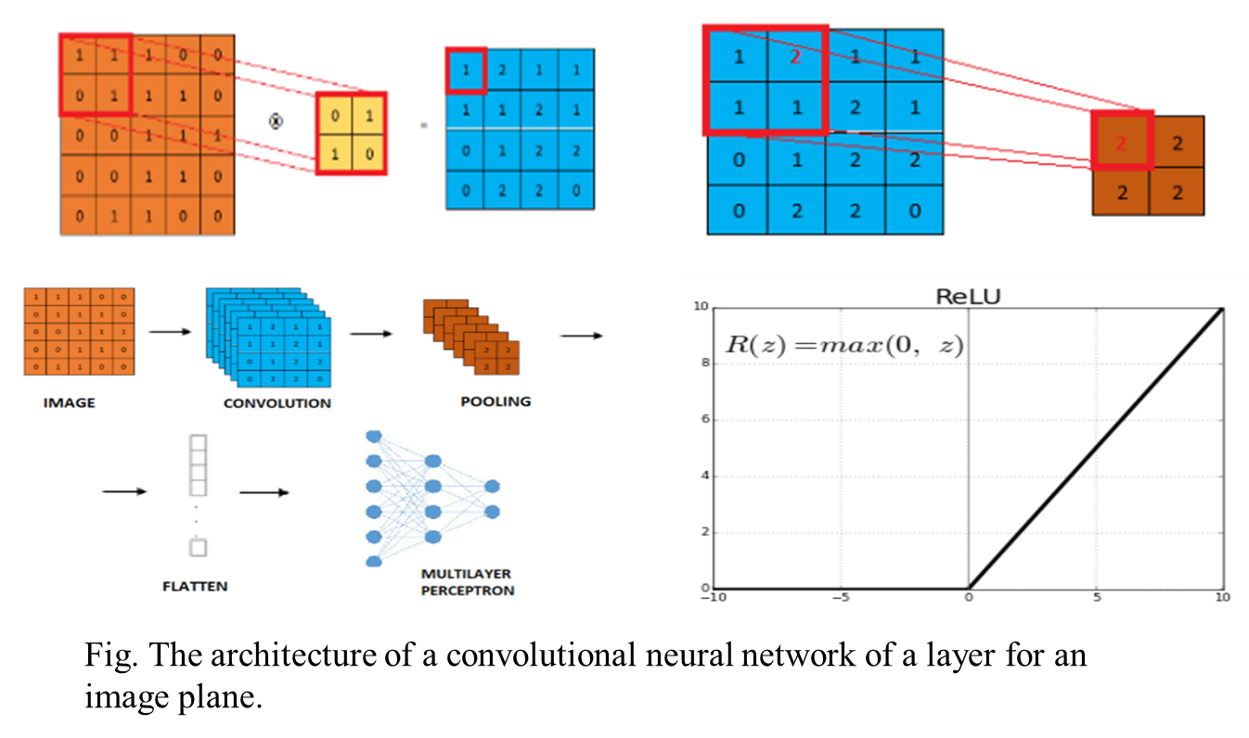

Slide 27
The following steps were used to develop the deep learning model
Obtaining the input dataset: Kaggle dataset
1
Data arrangement: Into 4 categories ; C,G,N,D
2
Splitting of data to train, test and validation:80%,10%,10%
3
Model Designing:VGG16 from scratch and by Transfer Learning
4
Model Training: for 40 epoch for both model
5
Plotting the Training and validation accuracy of the models.
6
Plotting the Training and validation losses of both the models.
7
Using the 10% of the test data, prediction and calculation of performance parameter.
8

Slide 28
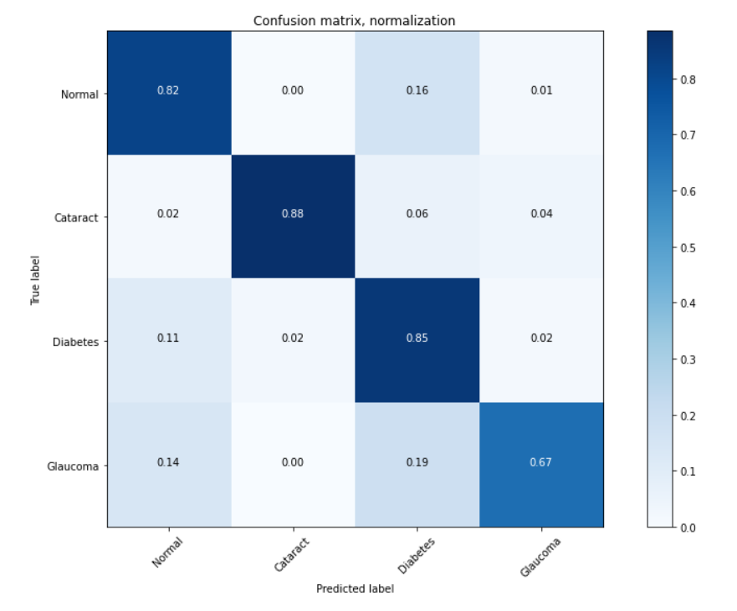
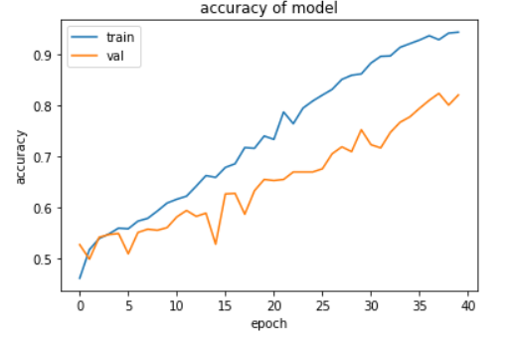
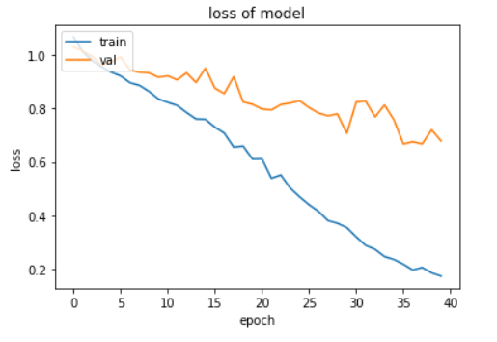
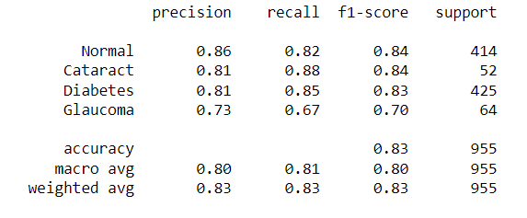
Result obtained from VGG16 (built from Scratch) model

Slide 29
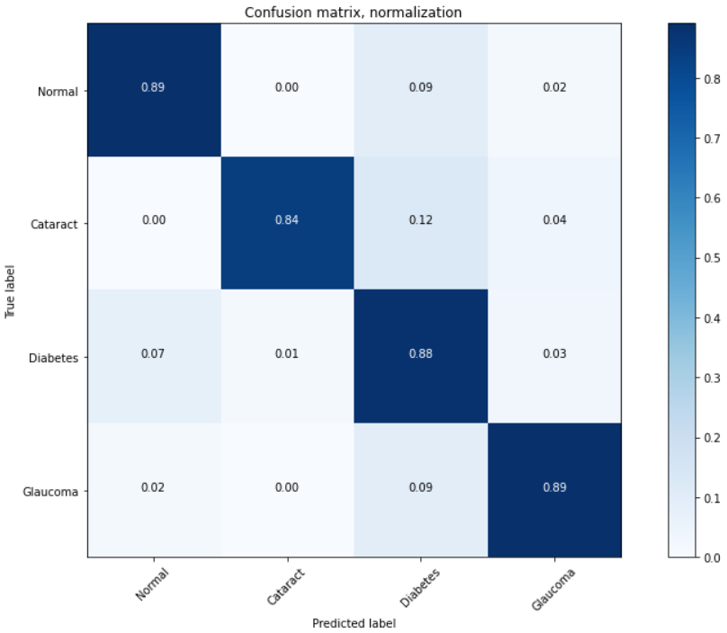
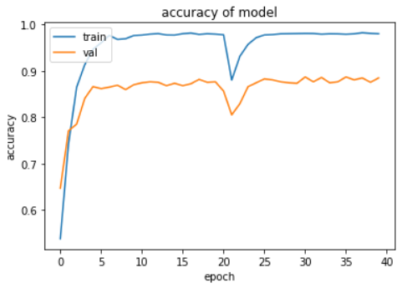
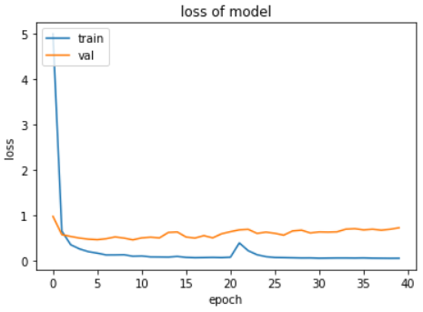
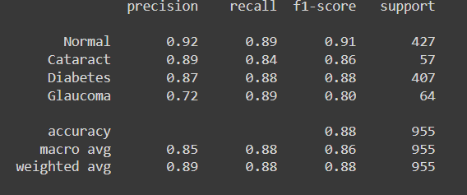
Result obtained from VGG16 model through Transfer Learning

Slide 30
Result
Regarding F1 score values, it is observed that the results almost reach the value of 1.
Random Forest accuracy 96.69% and F1 score close to 1
The result of accuracy was 88.38% obtained from VGG 16 trained through Transfer Learning and 82.72 obtained from Scratch Implementation of VGG 16 and 90% above in almost all Machine Learning model

Slide 31
Conclusion
Convolutional Neural Networks and Machine learning are the tools for classifying and can help the science of ophthalmology, especially relating to the global problem of Glaucoma and Diabetic Retinopathy.
The proposal shows numerical metrics that are almost perfect (Accuracy, Recall, Specificity Precision, and F1 score are close to 1.)
Our model gives big insights of features through image processing technique compared to related work.

